Slide 1
Liv Student Porto Single Studio
Room Amenities
Location
Single bed
AC
Private bathroom
Kitchenette
Desk & chair
High speed Wi-Fi
Weekly cleaning
Towels & bed linens
Kitchen Utensils
R. Manuel Pacheco De Miranda 205, 4200-804 Porto (see it here)
Facilities
Washing lounge paid separately, gym, rooftop, swimming pool, movies room, games room, lounge areas, 24/7 security
Price
Check-in: July 14
Check-out: August 6
€ 995

Slide 2
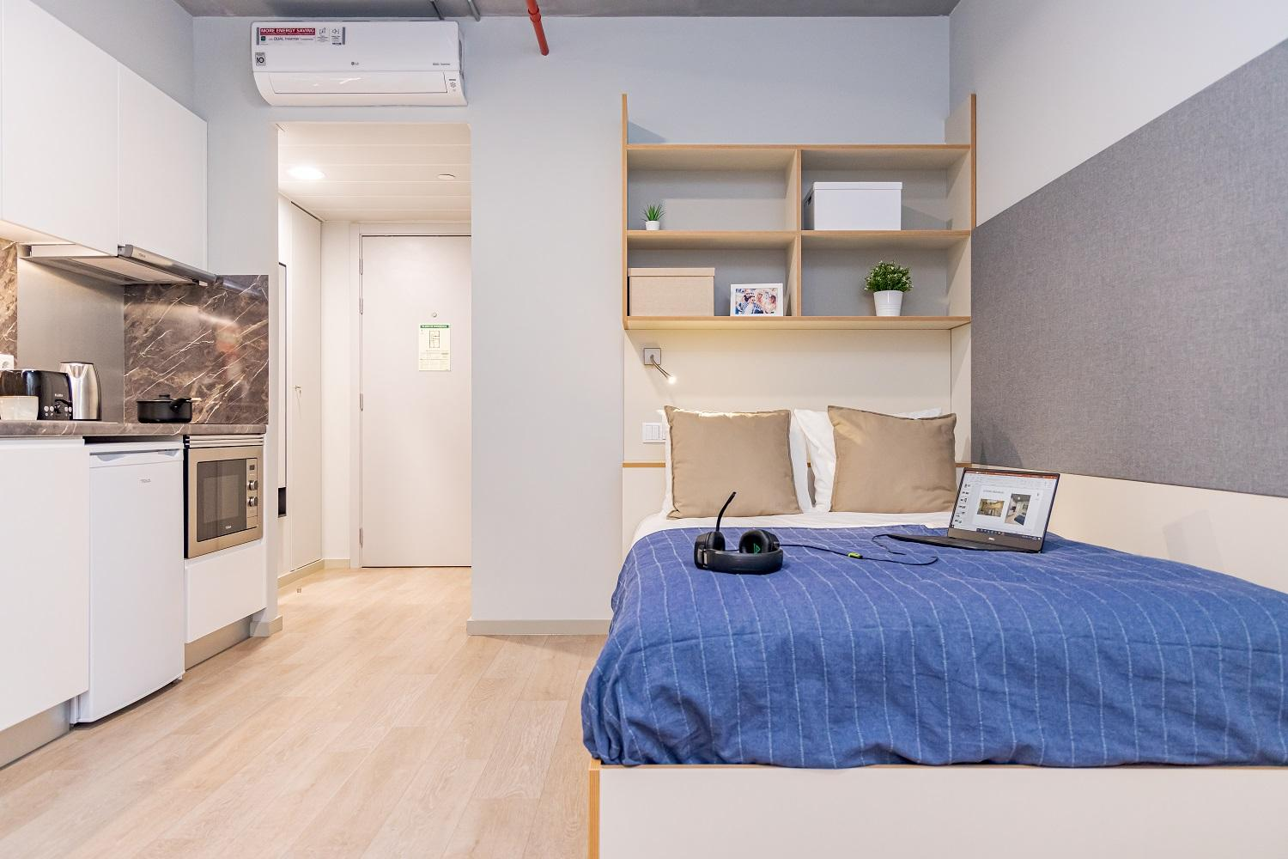
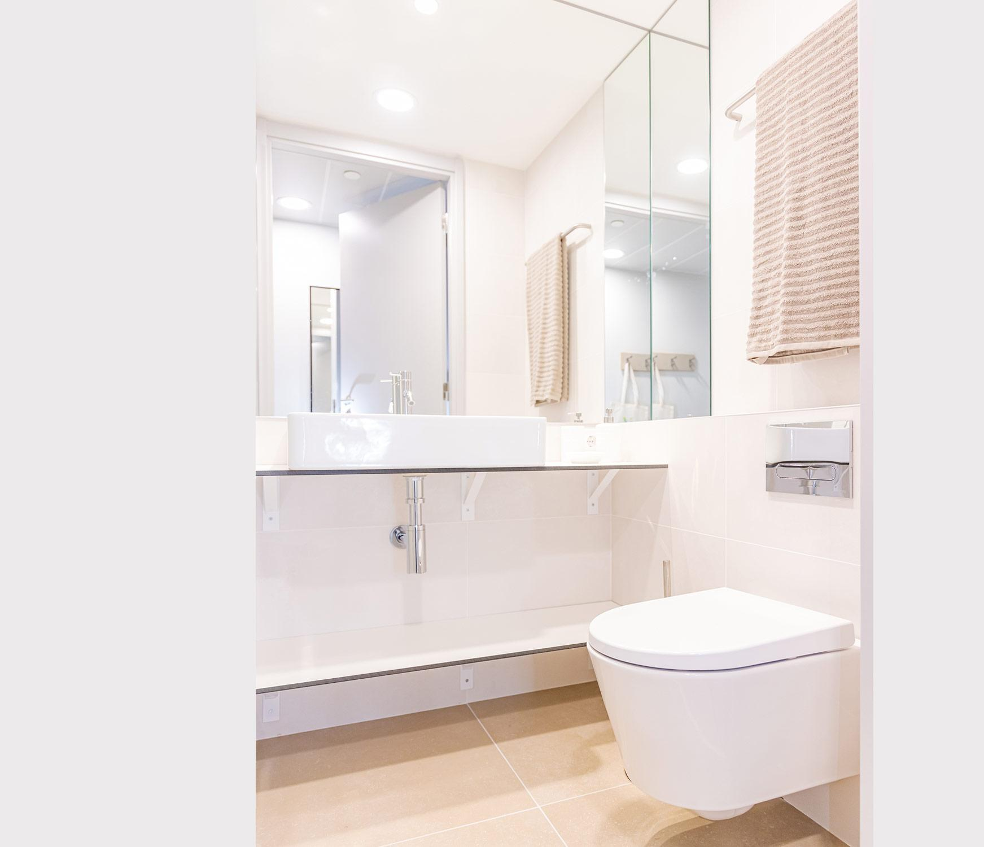
Liv Student Porto Single Studio

Slide 3
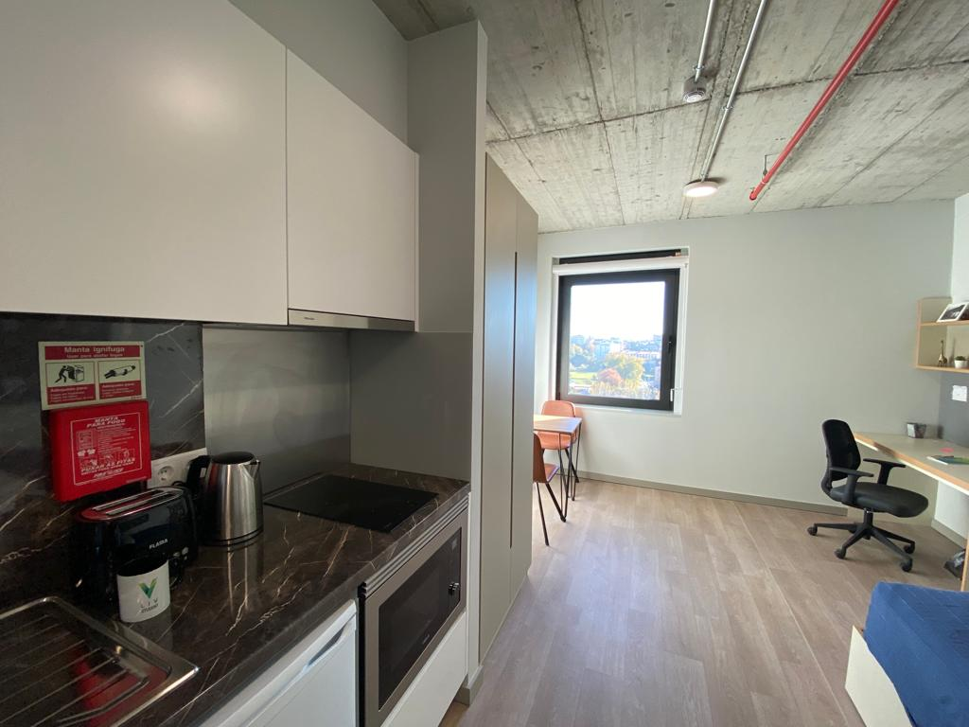
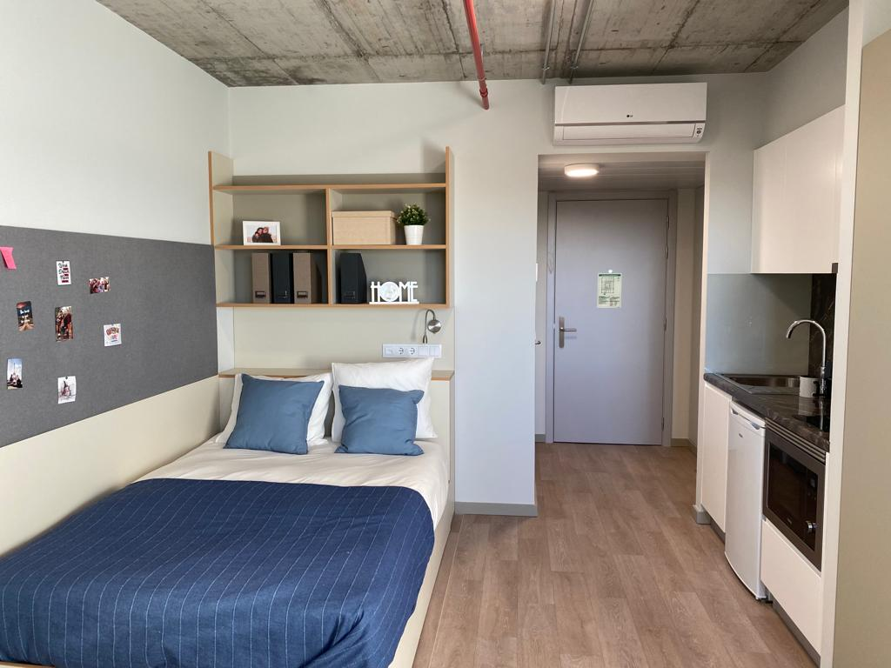
Liv Student Porto Single Studio

Slide 4
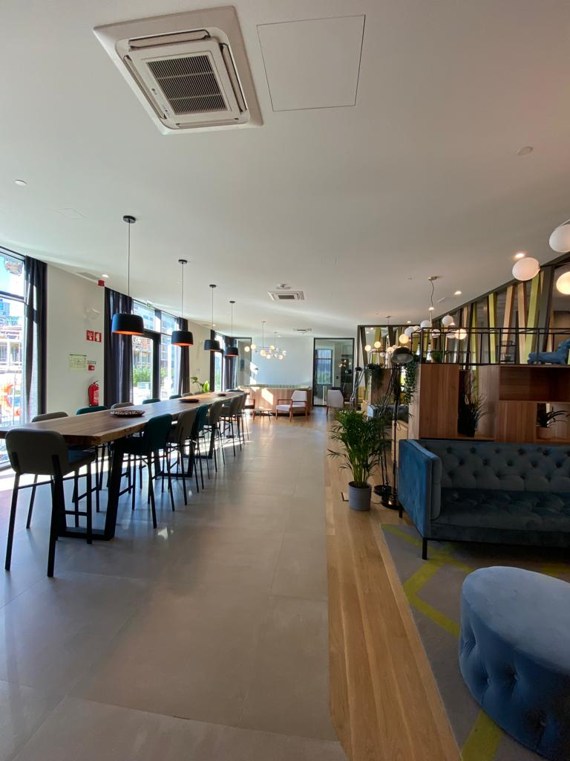
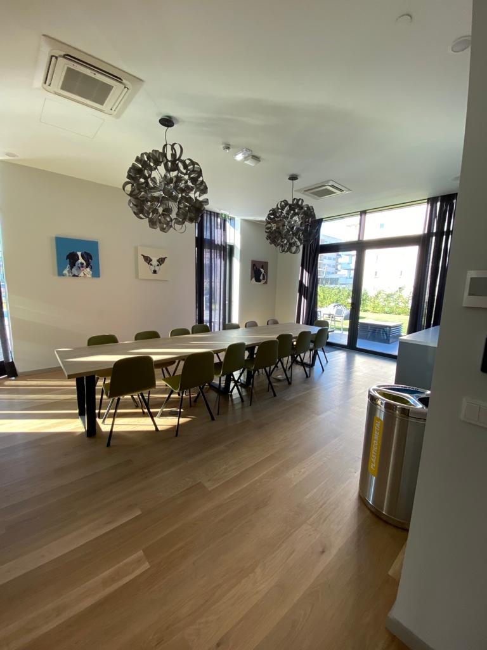
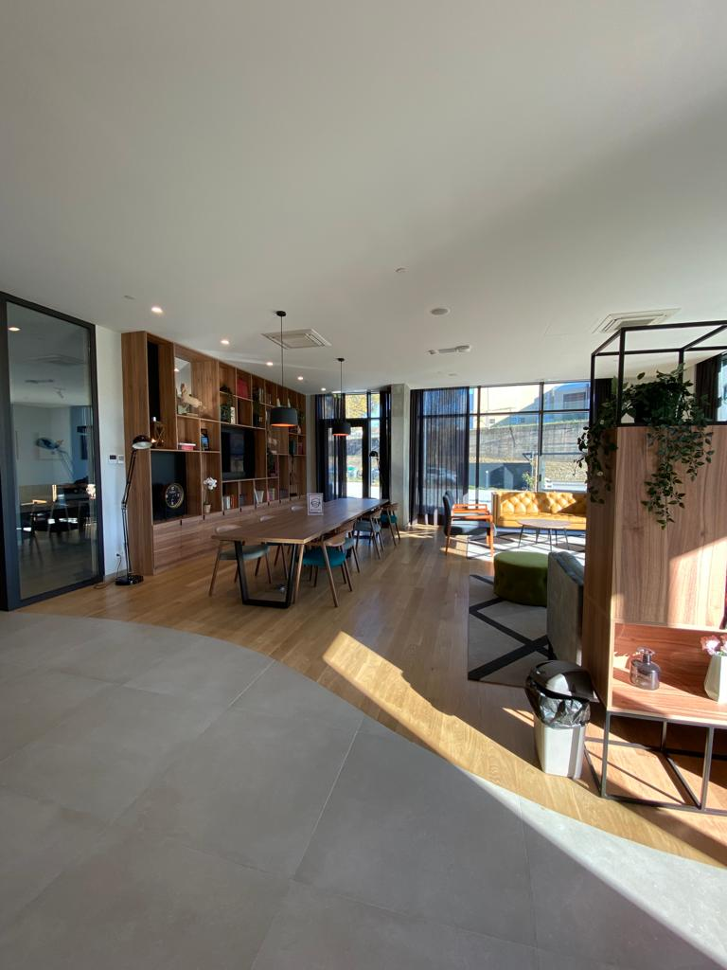
Liv Student Porto Common Areas

Slide 5
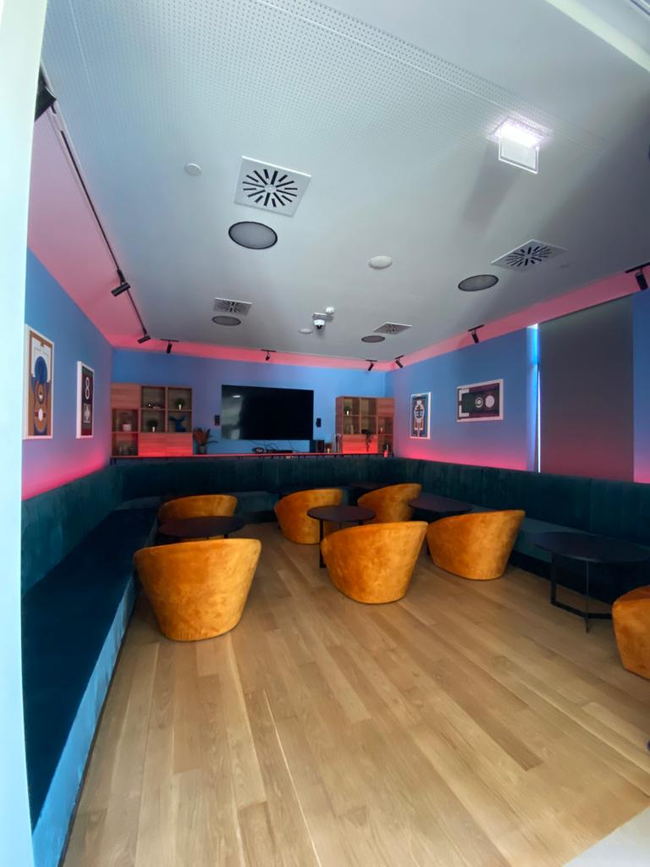
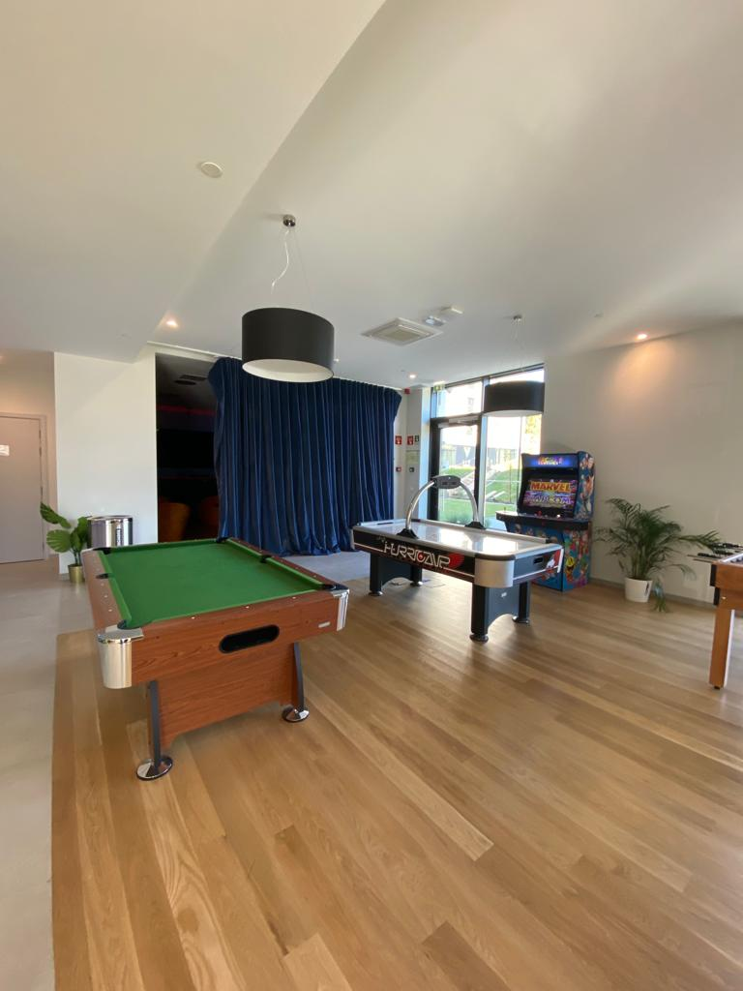
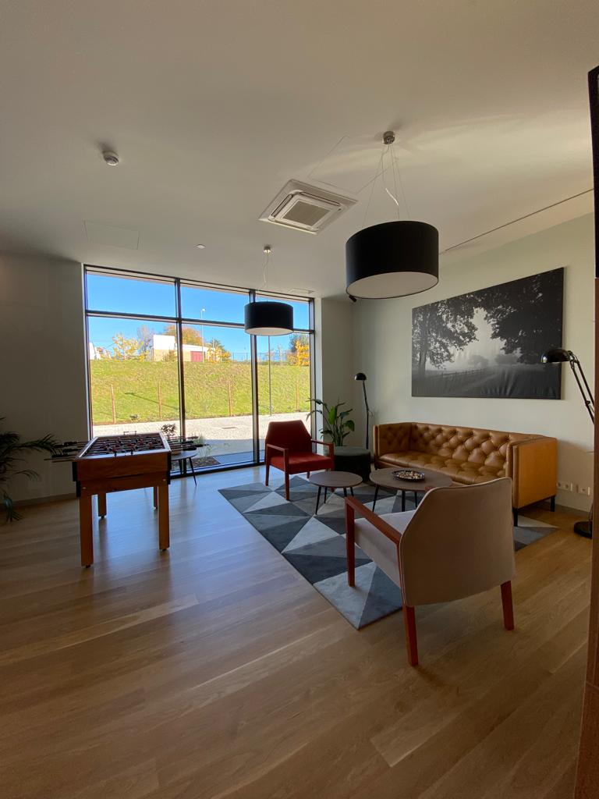
Liv Student Porto Common Areas

Slide 6
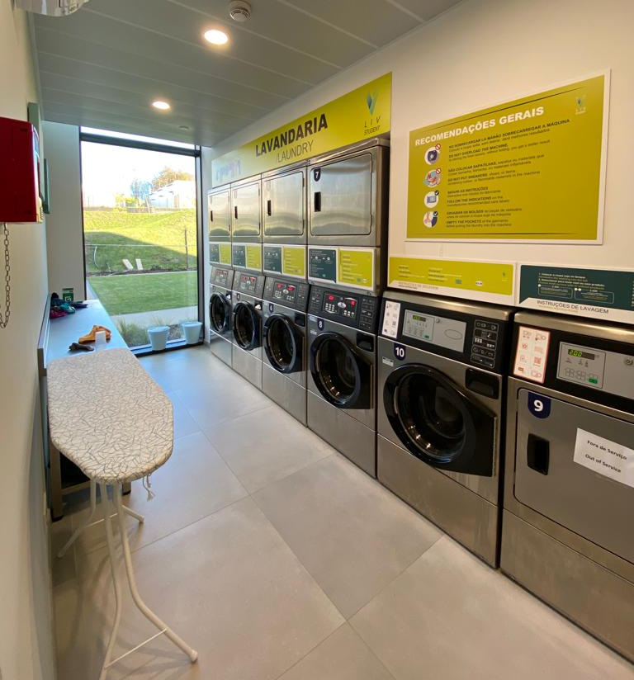
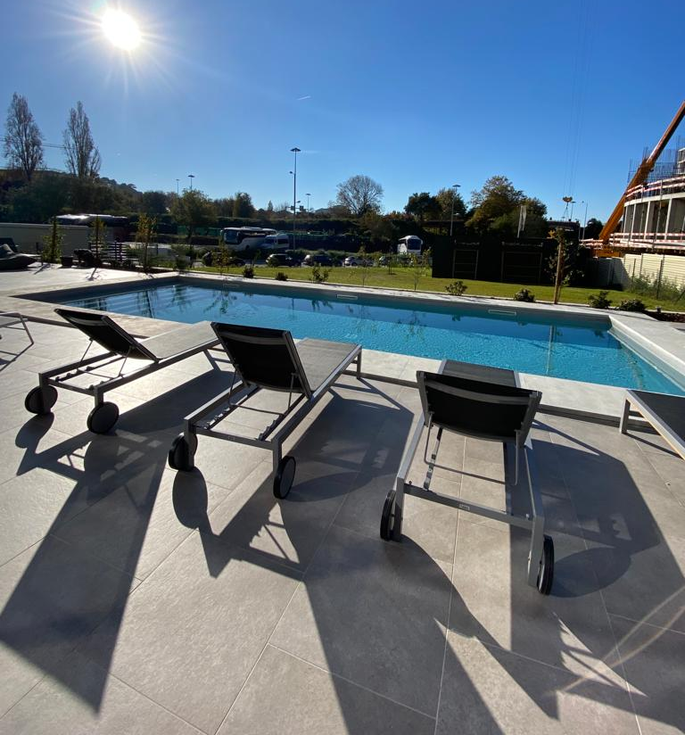
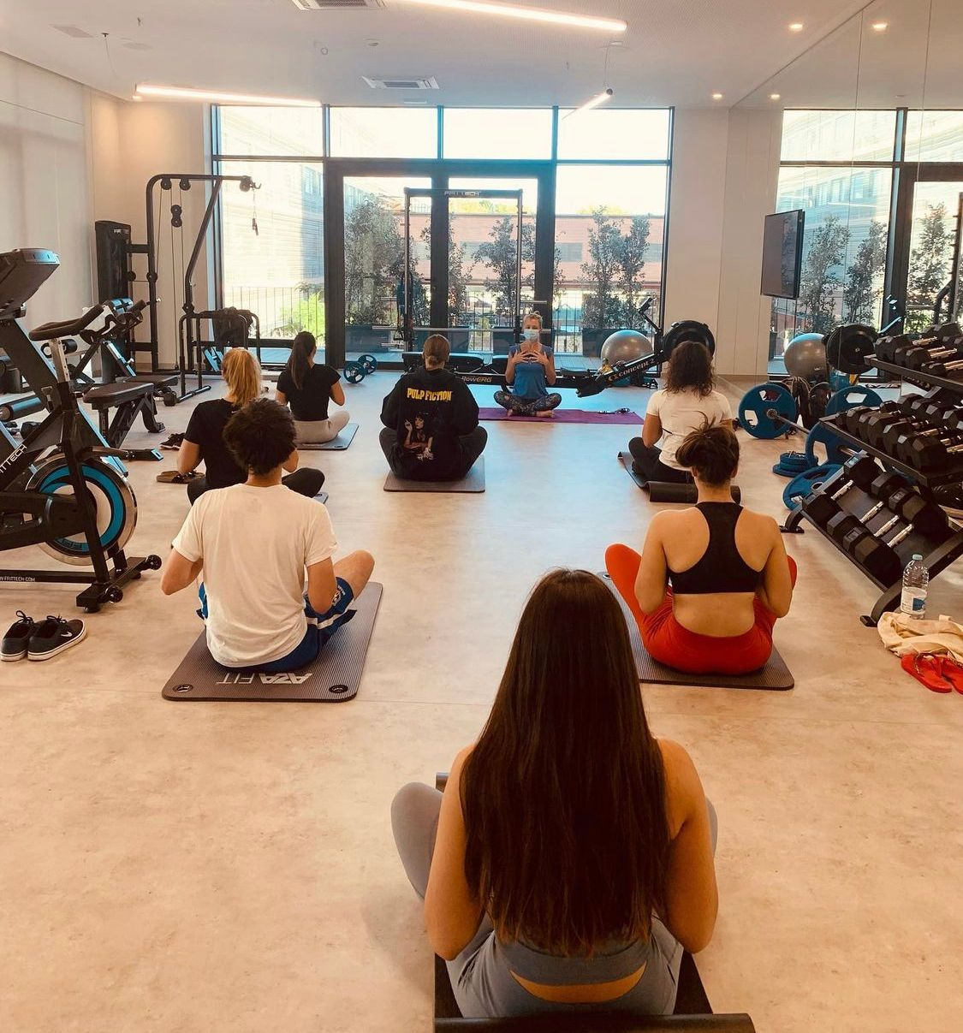
Liv Student Porto Common Areas

Slide 7
Liv Student Porto Important information
EIA will not be responsible for any damages caused by the participants. The students must sign a notice of entry when they check-in, which will include:
Responsibility form,
Regulation form;
List of the existing equipment in the unit, indicating the state of conservation of the equipment and unit.

